Slide 1
Καιρος – Team Atrius
Noah Gallo, Nathaniel Kanooni, Isaiah Hogue, Colby Nelson, Tre Carlton

Slide 2
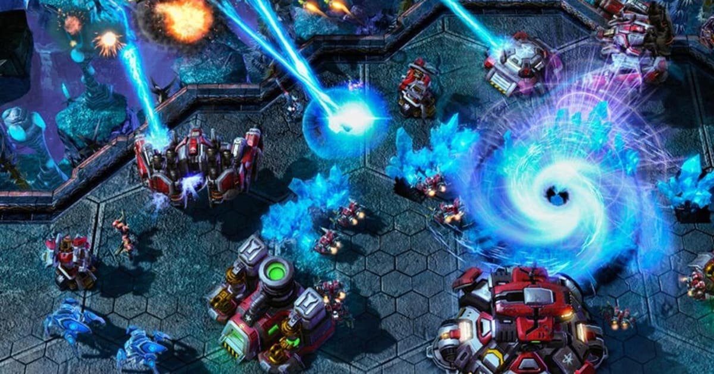
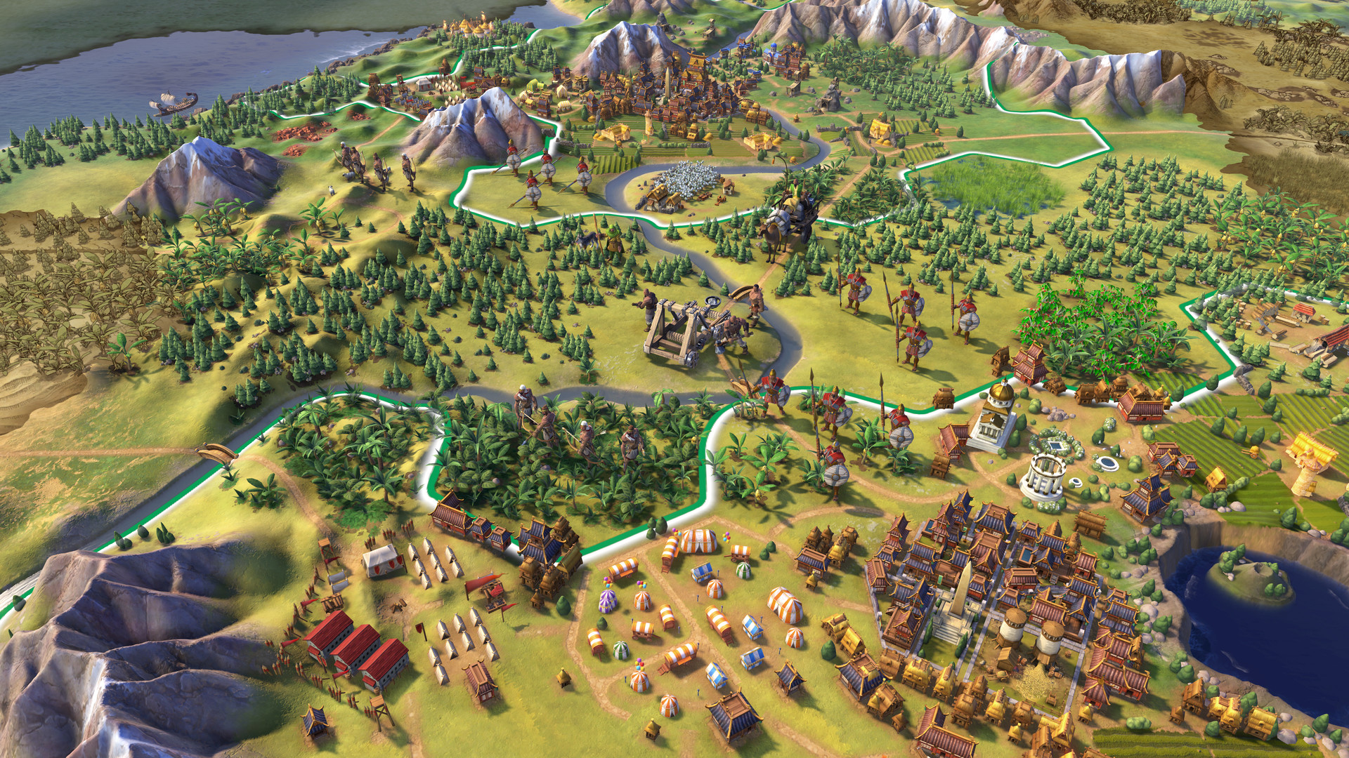
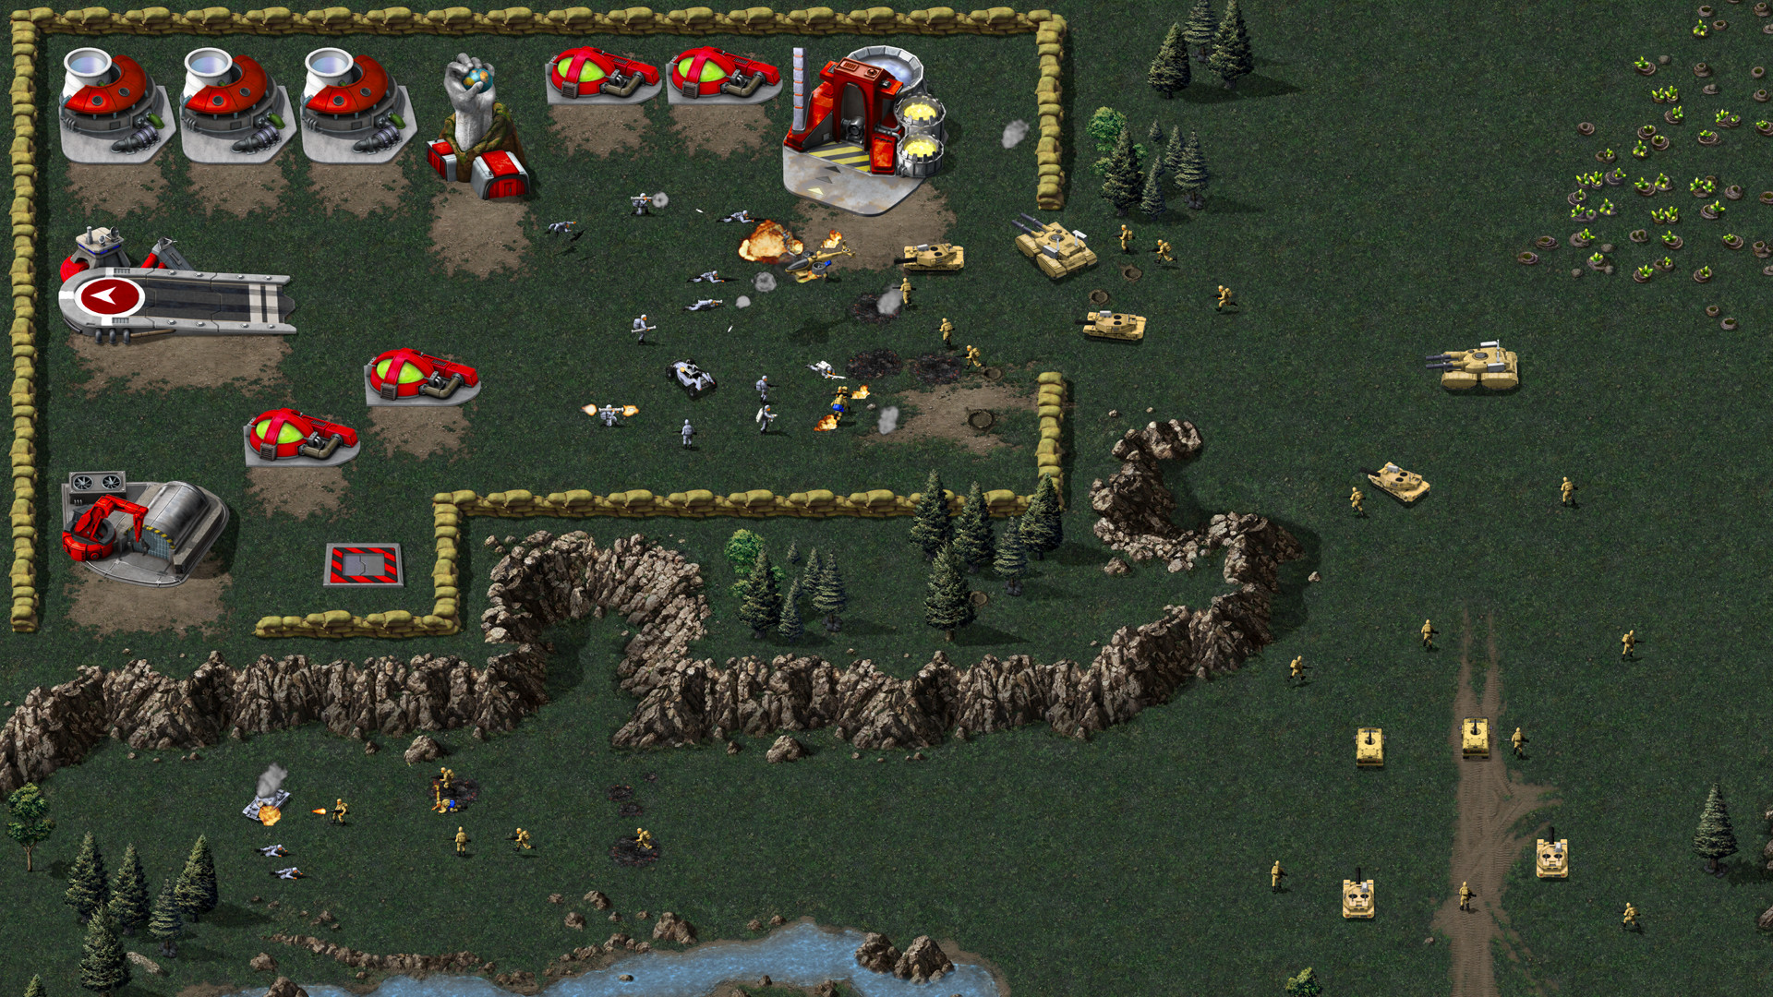
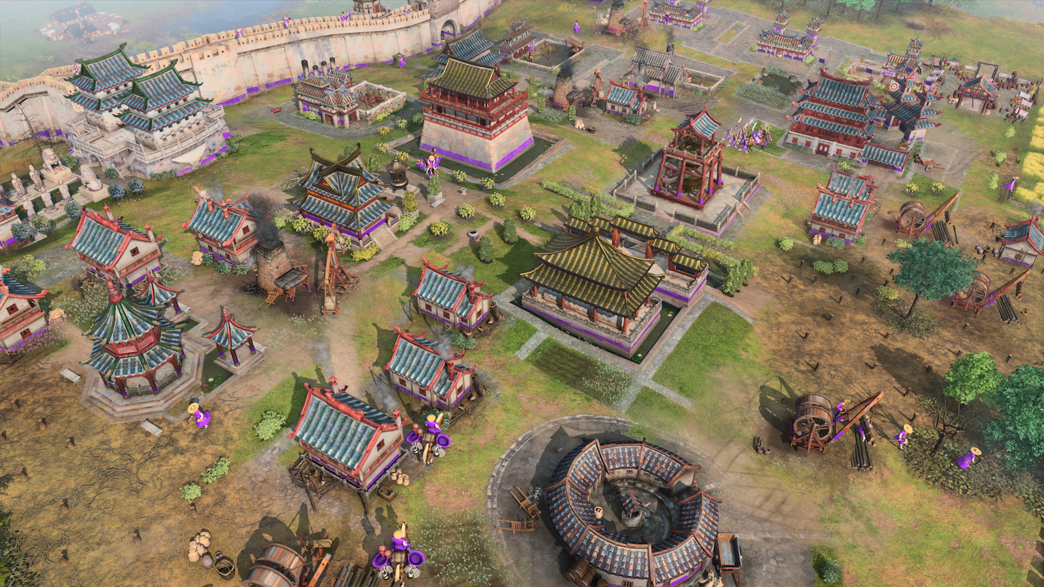
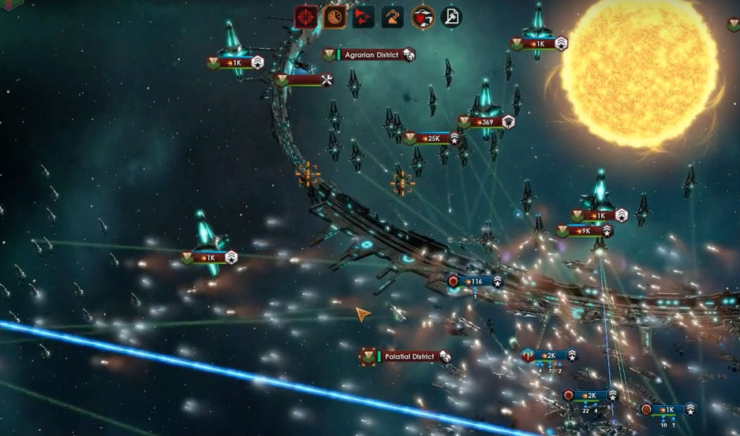
What is Καιρος?
Empire Builders
Real Time Strategy
StarCraft II
Sid Meyer’s Civilization 6
Command and Conquer Remastered
Age of Empires IV
Stellaris

Slide 3

Audience

Slide 4




Tools
Visual Studio
Unity Engine
Jira

Slide 5

Deployment
Steam

Slide 6

Goals

Slide 7
User Stories
Every time the Player begins a new journey, there will be a randomly generated map that makes gameplay varied and unique
“The world does not revolve around the player”
The player will be able train hero's and leaders to run their nation and armies when the player is preoccupied
Players will be able to choose their path of diplomacy or war to becoming the largest nation

Slide 8
Technical Goals

Slide 9
Technical Goals
3D Vectors and Rendering
CPU Opponent
Map Generation
Path Finding

Slide 10
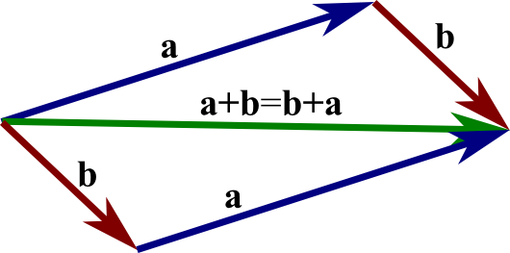
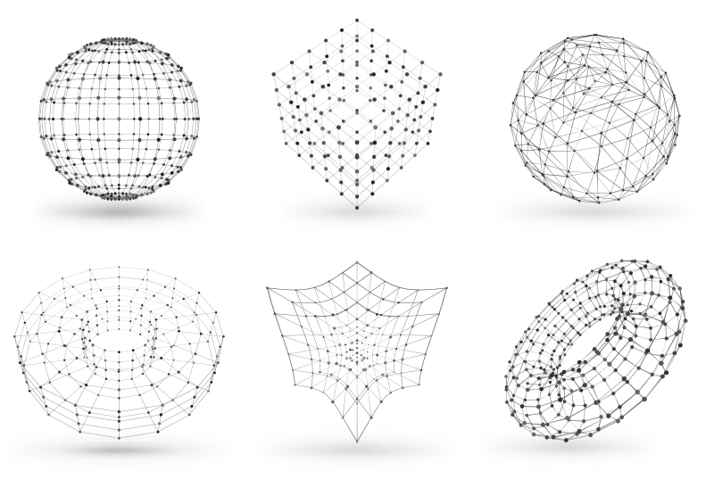
3D Vectors and Rendering

Slide 11
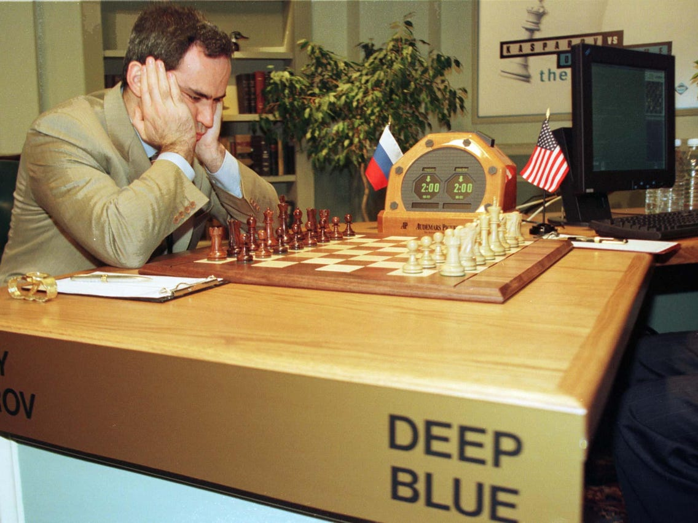
CPU Opponent
Deep Blue playing Gary Kasparov

Slide 12

Demos

